Slide 1
Taking the Scary out of Scala
Anna-Maria Wykes
Data Engineering & Cloud Consultant

Slide 2

Who am I?
Senior Advancing Analytics Consultant
Data Engineering & Cloud
Over 14 years’ experience working in Software & Data Engineering, most recently working with Scala, Kafka and various cloud tech
BSc in Multimedia Computing & Business, and a HND in Visual Communication
@annawykes
anna-maria-wykes-31939454

Slide 3
What makes me tick?
Passion for Data and strive to bring the worlds of Software Development and Data Science closer together.
Helped to organize/run local Code Clubs
Organize and volunteer at local events
Other areas of interest include UX, and Agile methodologies

Slide 4
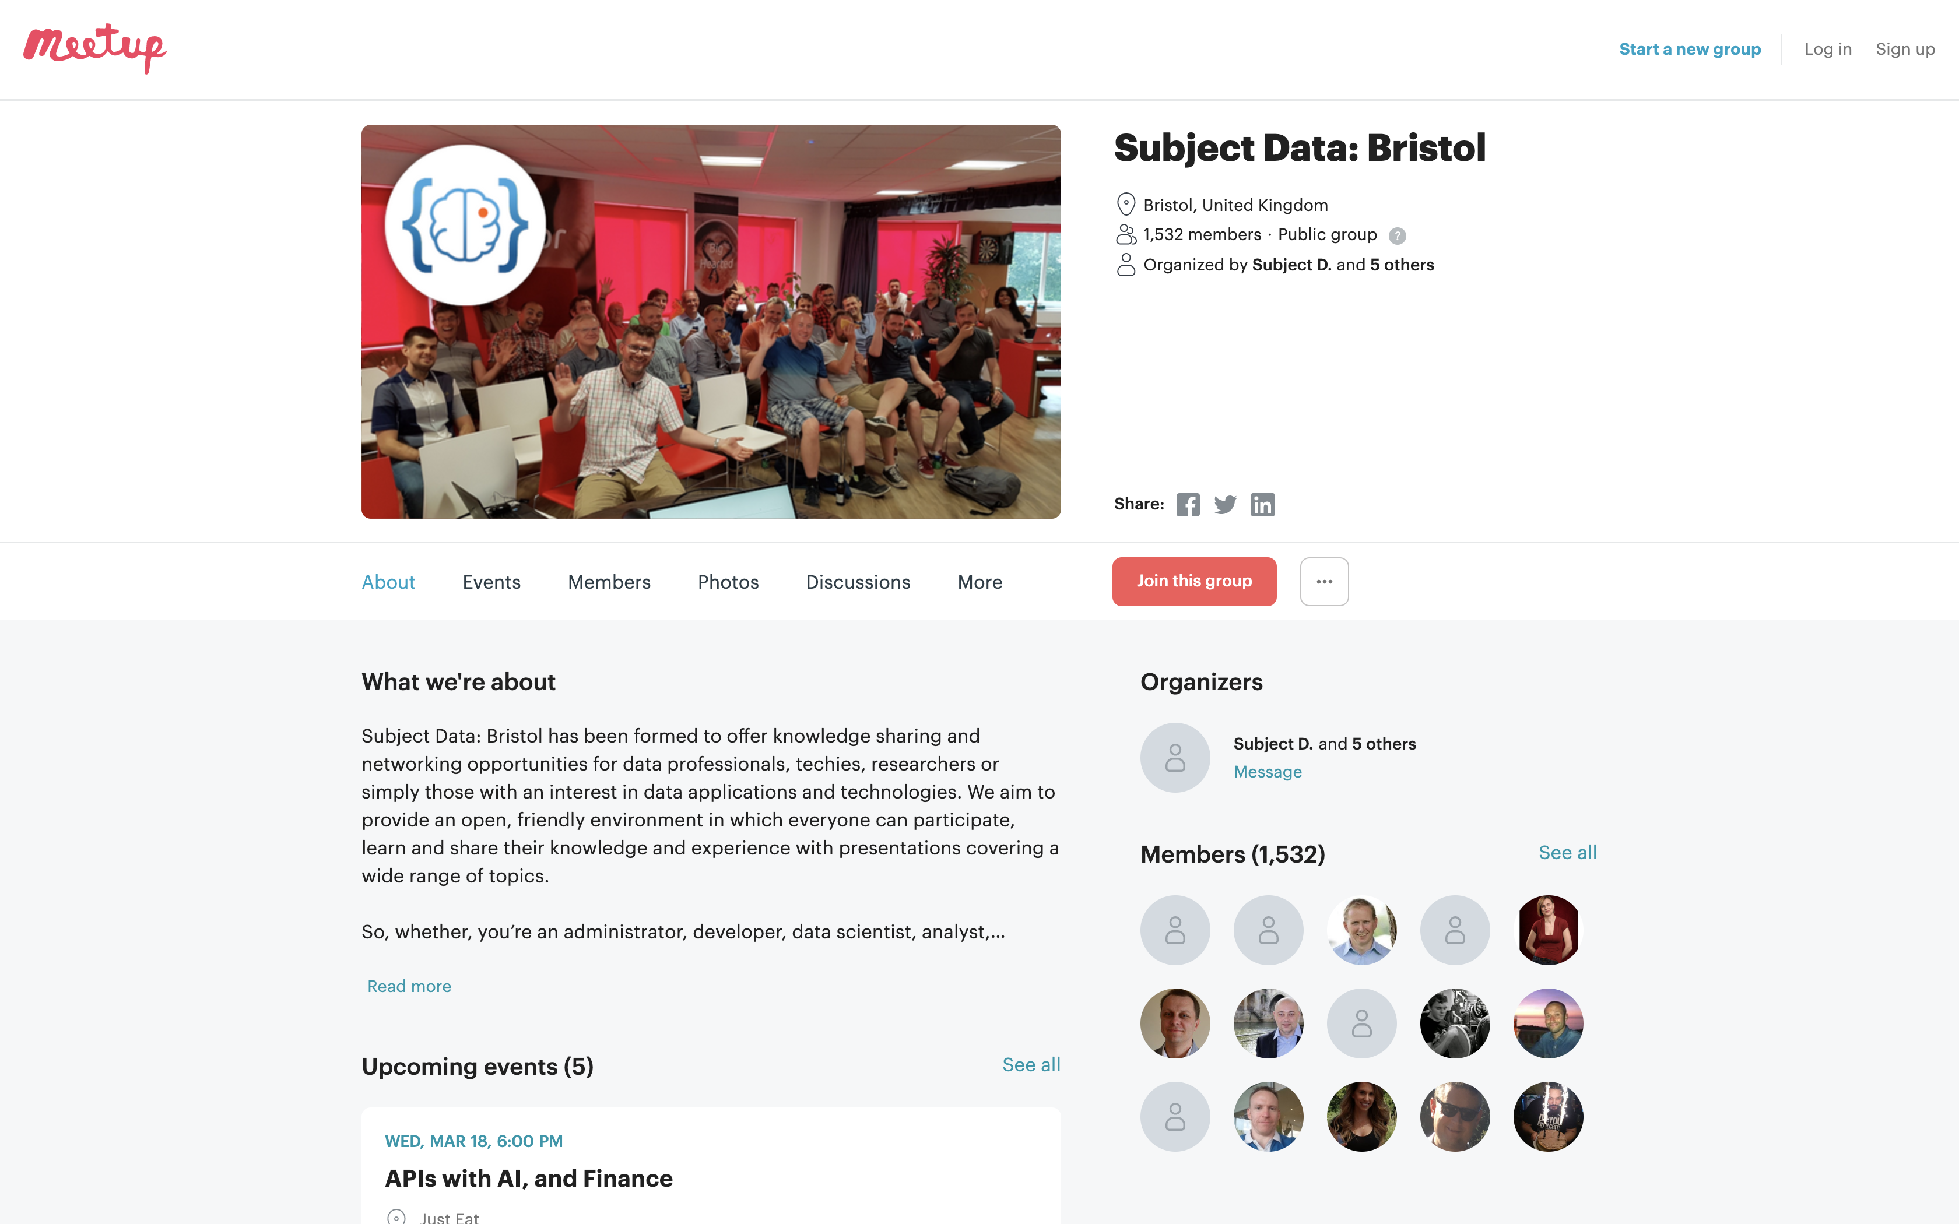
MEETups and Community Groups

Slide 5

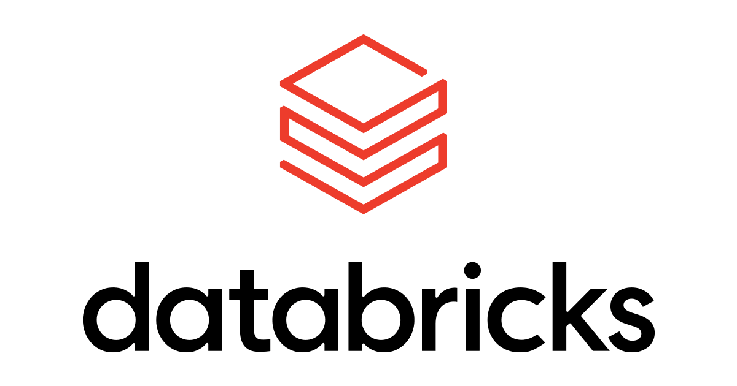

What are we going to do………

Slide 6
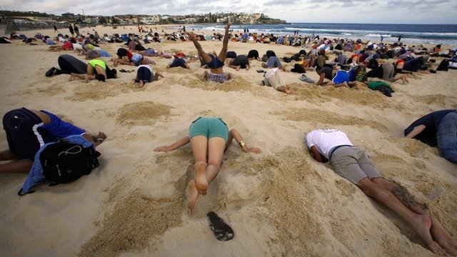
WHY?
Notes:
Spark & Databricks is written in Scala under the hood
It is inevitable you will have to work with Scala at some point
Common packages written in Scala

Slide 8

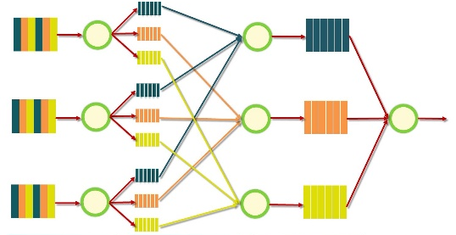



Google MapReduce Papers
2004
Google File System Papers Released
2006
2003
Databricks blurb
Apache Hadoop project created
Matei Zaharia starts Spark project
Project donated to Apache Foundation
Databricks founded by Matei
2012
2013
2013
Notes:
Evolution of distributed data
Evolution of distributed compute

Slide 10

What is Scala?
Object Orientated and Functional programming paradigms
What is Scala used for? A lot of things, ranging from
Machine Learning to Web Apps
The name Scala stands for “scalable language.” The language is so named because it was designed to grow with the demands of its users

Slide 12
The ultimate teaching language?

Slide 13






Who Uses scala

Slide 14
Software written in scala

Slide 15
But still, why bother….
Notes:
Transferable, portable skills in their day job
Scala is multipurpose, meaning you can use if for anything from a simple web app to ML
Learn Functional Programming
Competitive skill set
It has a solid community behind it
It is Type safe

Slide 16
Types safety means you can’t turn a cat into a dog

Slide 17
Basics of Scala What are we going to look at?
Case Classes
Option
Pattern matching
Map & FlatMap
Reduce and Filter
For Comprehensions

Slide 18
Case classes
Good for modelling immutable data Act like blueprints

Slide 19
Case classes

Slide 20
OPTIONS
Handles empty values without error

Slide 21
The NULL Mistake
“I call it my billion-dollar mistake. It was the invention of the null reference in 1965” — Tony Hoare, 2009

Slide 22
How does Scala handle Nulls: Options
A Scala Option holds zero or one element of a type. This means that it is either a Some[T] or a none object. One place we get an Option value is through the get() method for a Map
SOME = Something
NONE = Nothing

Slide 23
MAP
Opens the box of data and transforms it accordingly

Slide 25
FLATMAP
Opens the box of data, transforms it, and flattens it accordingly

Slide 26
When you forget to use flatmap

Slide 27
REDUCE AND FILTER
Sum everything up Only get the data you need

Slide 29
FOR COMPREHENSION
Monads

Slide 30
Functional Programming: Monads
Step One
A Monad is a sequence of events with a get out of jail card
Step Two
Step Three

Slide 31
Summary
Gone over some of the basics
Apply these when working with Scala in Databricks
Be able to understand Maven and Spark packages
Robustly test code
Create a portable Jar

Slide 32
Useful links
Learning
https://www.scala-exercises.org/
https://scala.epfl.ch/
https://www.coursera.org/specializations/scala
https://typelevel.org/cats/
https://medium.com/disney-streaming/tagged/thisweekinscala
Conferences
https://scaladays.org/
https://scala.world/

Slide 33
THANK YOU
https://github.com/AnnaWykes/scala-for-big-data
anna-maria-wykes-31939454
@annawykes

